Slide 1
How can ChatGPT improve economic education in Virginia?
Lena Caffall
VAE Conference 2023
Notes:
Slide 1: Good morning, thank you so much for the introduction. My name is Lena Caffall, and I will be presenting my research investigating how ChatGPT can improve economic education in Virginia.

Slide 2
Introduction
-Second year student at James Madison University
-Elementary Education major with minors in Spanish and Public Policy
-Research Experience for Undergraduates (REU)
in the JMU College of Business
-With Professor Kruggel
Notes:
Slide 2: For a brief introduction of myself, I am a second year student at James Madison University, majoring in elementary education with minors in Spanish and Public Policy. After taking a few economics courses during my first semester, I decided to participate in the Research Experience for Undergraduates through the JMU college of business, which provides an opportunity for JMU students to work with a professor to assist with research and learn research skills while exploring topics of interest. I work with Professor Kruggel, a professor of economics to further explore my interest in econ ed. Our project with economic education on field trips reached a bit of a standstill, so we switched gears to look at innovations in economic education, one of which is ChatGPT.

Slide 3
Background
“ChatGPT has Mastered the Principles of Economics: Now What?”
(Geerling et al., 2023)
“How to Learn and Teach Economics with Large Language Models, including GPT”
(Cowen & Tabarrok, 2023)
Notes:
Slide 3: For some background, we looked at the literature, which is rapidly developing, and these two papers provided some good insight. A paper from Greeling et al, touches on some of the accomplishments of ChatGPT, such as the many tests it has passed, for example, the paper describes how “ChatGPT ranked in the 91st percentile for Microeconomics and the 99th percentile for Macroeconomics when compared to students who take the TUCE exam at the end of their principles course.”
If needed- “The National Council on Economic Education (NCEE) created the “Test of Understanding of College Economics” (TUCE)”
The paper then highlights potential impacts of chatbots in education, such as the need to prevent cheating with more proctored and in person exams and adapting curriculum to focus on hands-on learning.
Additionally, a paper from Cowen and Tabarrok provides an overview of the ways to use chat GPT. This article provides background on the way in which the program works and how to most effectively use the AI, as well as useful skills, strategies, tips and tricks for using AI technologies like ChatGPT.
Looking at the abilities of ChatGPT, I wanted to see the ways in which the AI was able to provides answers and reasoning for assessments of economics used here in Virginia

Slide 4
My Research
-ChatGPT answered released SOL test questions related to economics
-Provided an answer and rationale to each question
Notes:
Slide 4: Rather than beginning with a hypothesis, we used a more grounded theory approach and decided to test the abilities of ChatGPT and then see what we could learn from its answers. Since we wanted to focus on education in Virginia, we pulled any questions related to economics from the released SOLs, including the grade 3 history sol, the civics and economics sol, and the world geography SOL. We asked chatGPT to provide the correct answer to each of these multiple choice questions and also provide a rationale for why that answer was correct.

Slide 5
Results
56 out of 59 correct
-rationales provided insight of how ChatGPT can assist teachers and improve economic education in Virginia
Notes:
Slide 5: We were not surprised that ChatGPT got 56 of these 59 questions we asked it correct.
However the rationales were the important part because as I began to analyze the data and the responses from ChatGPT, I realized how the rationales the AI produced can assist teachers and be used to improve economic education.

Slide 6
Implications
More Narrow
improved preparation for economics questions on SOL tests
More Broad
Improved teaching of economics and creation of better assessments of economics content
Identify specific topics instructors need to cover prior to assessing a concept
Identify the thought processes used by students when answering assessment questions
Notes:
Slide 6: The rationales provided by the chatbot have both narrow and broad implications for economics education. On a more specific scale, the responses I found showed how using ChatGPT can help teachers to better prepare the students for the economics questions on the SOL tests. On a more broad scale, the responses can be used to improve teaching of economics and promote the creation of better assessments because the rationales provided by ChatGPT can be used to Identify specific topics instructors need to cover prior to assessing a concept and to identify the thought processes used by students when answering assessment questions

Slide 7
improved preparation for SOL tests
Understand how content knowledge is needed to answer questions
Better understand question styles and wording
Better sense of what kind of thinking is needed to answer standardized test questions
Notes:
Slide 7: First, we can look into how this method can help teachers to better prepare their students for the economics questions. If teachers go through this process of putting economics SOL questions into ChatGPT to receive rationales, the teachers will be able to see how specific content from the Standards is needed to answer questions. This process also gives teachers a better understanding of the question styles and wording and how a student would need to think or process the content knowledge/ question style to properly answer the question.

Slide 8
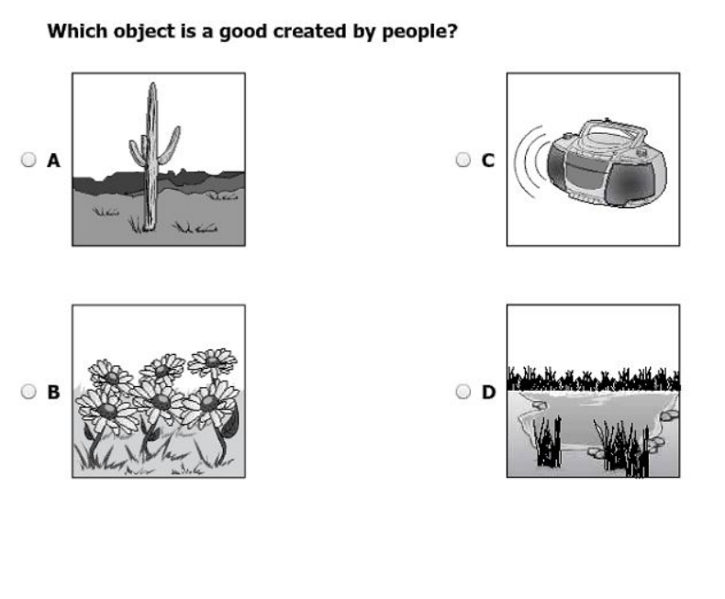
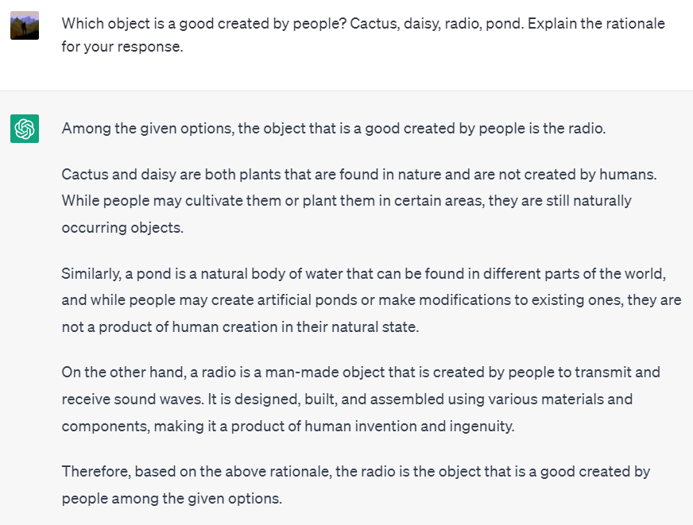
2014 Released Grade 3 History SOL Test
Notes:
Slide 8: This is question 22 from the 2014 released grade 3 history SOL test. This is a unique style of question with four pictures as the answer choices. When plugging this into ChatGPT, we listed what was shown in each image, but the rationale provided some insight into how a student might answer this question. The rationale includes an explanation of how each image or object is made by people or not, and this is a great strategy that teachers can advise to their students- if you see a question on the SOL with four pictures as your answer choices, go through each picture and determine if that picture answers the question. This question also gives insight into how students may think about goods created by people versus goods created by nature and challenges students may present. For example, the Chatbot does reference how humans cultivate plants or could create a man-made pond, but then explains that these are naturally occurring. Therefore, when teaching about goods created by people, a teacher would want to emphasize how even though a human may cultivate a plant or make a pond, these still occur naturally and are not made by people like the radio.

Slide 9
Improved Teaching + Better Assessments
Identify specific topics or facts instructors need to cover prior to assessing a concept
Identify the thought processes used by students when answering assessment questions
Notes:
Slide 9: This process and research can also have more broad implications that can inform better teaching practices and assessments, as teachers will be able to determine specific topics or facts that should be covered prior to assessing a concept and see the thought processes used by students to answer questions. If teachers better understand what rationale can correctly answer a certain assessment question, they can confirm that the question they use will assess the correct material and then make sure they teach the content needed to develop that rationale.

Slide 10
Improved Teaching + Better Assessments
Understanding by Design Framework
(McTighe & Wiggins, 2011)
1) Identify desired results
2) Determine assessments evidence
3) Plan learning experiences and instruction
Notes:
Slide 10: Also, in a paper we are developing, we are looking into how the principles of understanding by design and how that theory can be applied in this process.
When looking at how to apply the ChatGPT rationales to improve teaching and assessments, we found it beneficial to incorporate the Understanding by Design Framework developed by McTighe and Wiggins, which is structure to guide curriculum, assessment and instruction that involves designing curriculum “backwards.” This process involves three stages- Identify desired results, 2) Determine assessments evidence, 3) Plan learning experiences and instruction. We found using the rationale provided by ChatGPT can help teachers identify effective methods for achieving all three of these stages. In stage one, McTighe and Wiggins suggest teachers ask questions such as What should students know, understand, and be able to do? And the rationales from ChatGPT can provide an example for both of those questions. By identifying what is necessary to answer each of these questions, teachers can better plan their curriculum to address student needs for addressing and assessing the content covered in the assements. In the second stage, teachers will be able to look at rationales to determine if the assessments they create are asseing the desired content based on the ChatGPT rationales, and in the third stage, instructors will continue using the knowledge they gained from the ChatGPT rationales in the first two stages to answer the questions McTighe and Wiggins developed for stage three: How will we prepare them to autonomously transfer their learning? What enabling knowledge and skills will students need to perform effectively and achieve desired results?

Slide 11
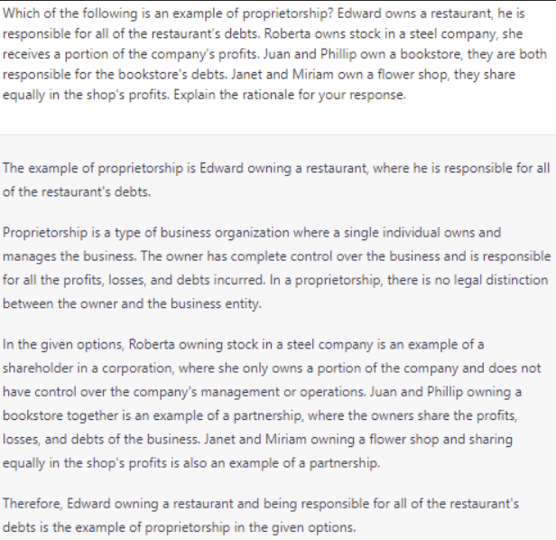
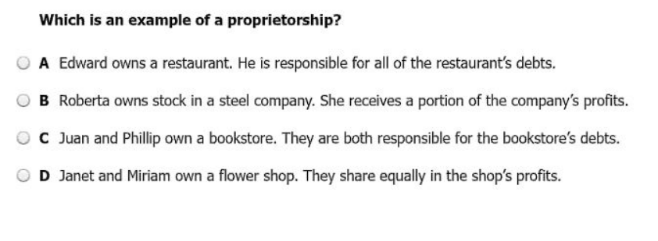
2014 Released Civics and Economics SOL Test
Notes:
Slide 11: This is question 28 from the 2014 released civics and economics test.
This question first shows what content knowledge students need to know related to proprietorships, as the rationale indicates to teachers that when teaching about proprietorships, they need to ensure that students understand that the sole proprietor is responsible for all of the debts. This question show how this question can actually cause students to think about and understand three concepts, proprietorships, partnerships, and corporations. The rationale explains how the second choice involves a shareholder in a corporation, while the final two choices are examples of partnerships. Therefore, a teacher could see how understanding all three concepts would help them to eliminate incorrect choices and select the correct choice.

Slide 12
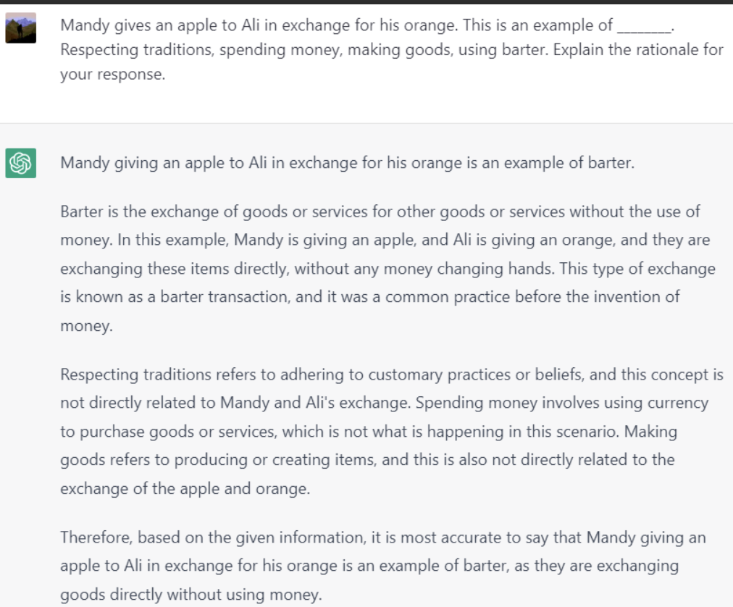
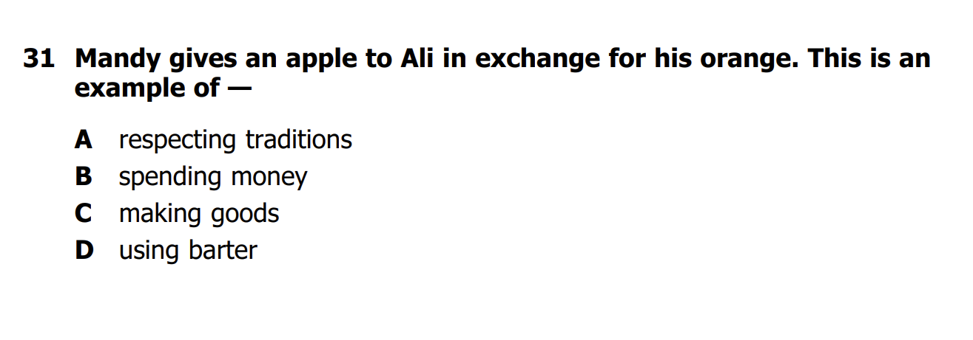
2012 Released Grade 3 history SOL Test
Notes:
Slide 12: This is question 31 from the 2012 Released Grade 3 history SOL Test. The rationale provided for this question shows how the student needs to know the definition of barter to understand the question. ChatGPT explains the thought process needed to eliminate the other answers and proves how to answer this question because To correctly answer this question, ChatGPT defines barter as the exchange of goods or services, Mandy’s apple, for other goods and services, Ali’s orange, without the exchange of money. Therefore, the student would need to understand this definition of barter to answer the question. The teacher could be using ChatGPT to check if this question assesses barter in the way they hoped or use it in the opposite direction and uses this question to determine how to best explain barter to their students.

Slide 13
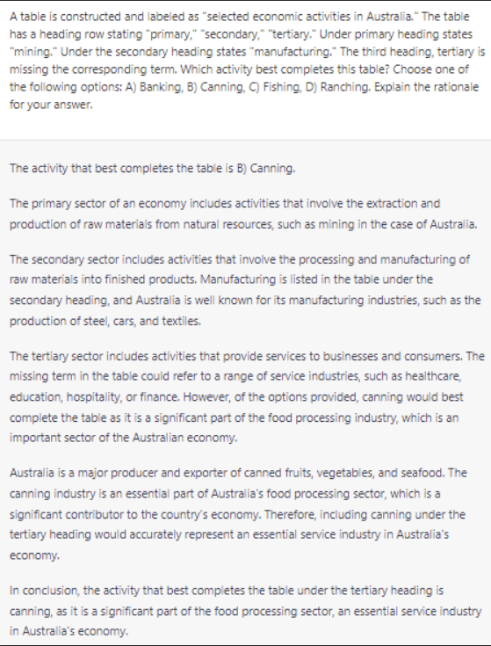
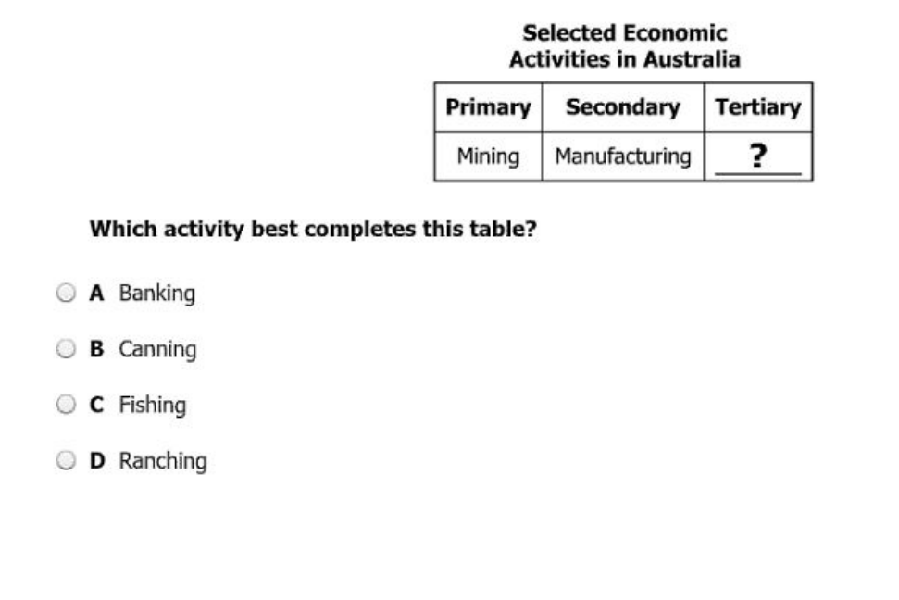
2014 Released World geography Test
INCORRECT ANSWER
Notes:
This is question 47 from the 2014 released world geography test. This is actually a question that ChatGPT answered incorrectly, but the rationale still provides interesting insight. First, it is important to note that this process is not yet perfect, and this is an example of when the question may be answered incorrectly. However, although ChatGPT answered the question incorrectly, the rationale proves that it does know the definition and examples of the tertiary sector services, as the rationale states, “The tertiary sector includes activities that provide services to businesses and consumers. The missing term in the table could refer to a range of service industries, such as healthcare, education, hospitality, or finance.” This shows how even when there is understanding of the tertiary sector, a student may not be able to correctly answer the question. In this case, a teacher would possibly want to address how banking is part of the tertiary sector, or explain how to better apply understanding of the tertiary sector. A teacher could also use this insight to phrase the question in another way or chose a new question to asses this content, as a student may experience the same confusion as ChatGPT.

Slide 14
Limitations + Areas for further research
Research the applications and effects of this process in a classroom setting
AI is not yet be able to effectively answer all types of questions and provide helpful rationales
Occasional incorrect answers
Rationales may include unnecessary information
Challenges with questions with images
Notes:
Slide 14: We would like to also acknowledge that our research is in its really stages, and we will be working on a further analysis of how this research can be applied in a classroom setting
Furthermore, it is necessary to acknowledge, as with any AI research at this time, that AI is still developing and learning. AI is not yet able to effectively answer all types of questions and provide helpful rationales, as it does very occasionally answer questions incorrectly or include unnecessary information in the rationale. Additionally, inputting questions with images still does include some extra human work and potential for error; however, all of these challenges may be addressed as chatbots continue to learn and develop.

Slide 15
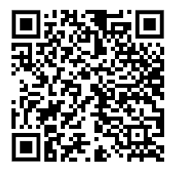
THANK YOU!
Contact Info:
Lena Caffall
James Madison University
caffalmr@dukes.jmu.edu
Notes:
Slide 15: Here is my contact information if you have any further questions, and a QR code that links to these slides.

Slide 16
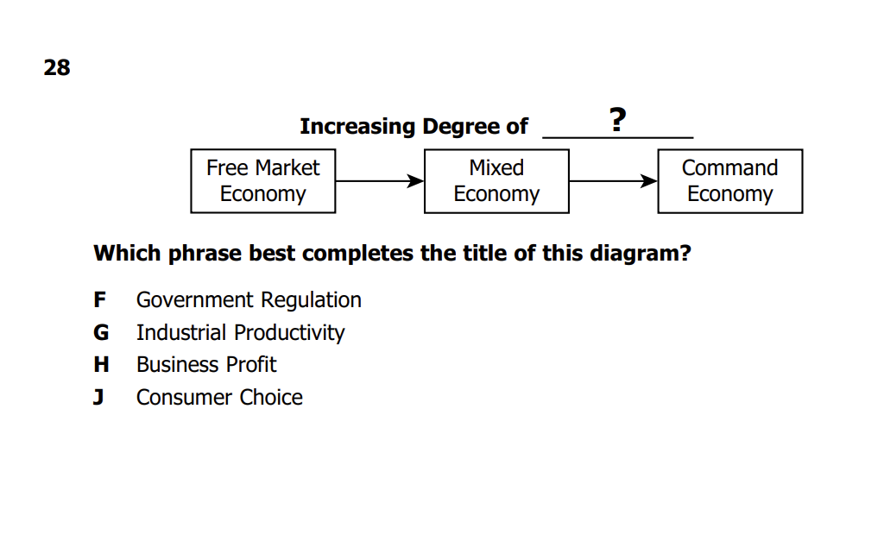
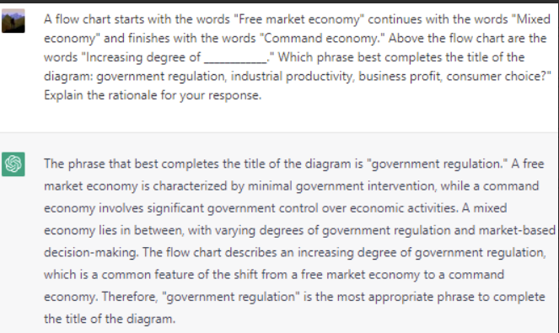
2012 Released Civics and Economics SOL TEST
Notes:
EXTRA QUESTION IF NEEDED!!!!
This is question 28 from the 2012 released Civics and Economics SOL. This shows how teachers can help their student understand a specific type of question on an SOL and how specific content will need to be applied to answer the question. In the rationale, we see that ChatGPT first provides a definition of each of the terms in the boxes, so the teacher would understand that a student would need to know the definitions of each of these types of economies. Next, we can see ChatGPT applies the style of the question to show how this flow chart is showing a SHIFT as it moves through, and also focusing on the title of the flow chart. Therefore, teachers can use this rationale to prepare their students for flow chart questions, advising the student to see how the title of the flowchart applies to the definitions they learned and to look for the shift or change while moving through a flow chart question.

Slide 17
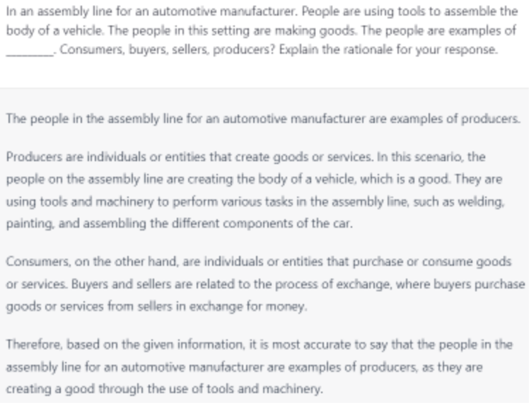
2012 Released Grade 3 history SOL Test
Notes:
EXTRA QUESTION IF NEEDED!!!!
This is question 28 from the 2012 released grade 3 history SOL test. The rationale from ChatGPT for this question can assist teachers in many ways. First, the chatbot explains how using tools and completing tasks such as painting and welding, like in the image, are indicative of a producer, so when teachers are introducing producers, they want to make sure to highlight how produce participate in these kinds of activities and use materials such as tools. As with the previous question, the rational also indicates that understanding the definitions of the other option choices, buyers, seller, and consumers, will help students to eliminate the incorrect and select the correct one, meaning a students could benefit from learning consumers, buyers and sellers before answering this question. Finally, the rationale shows how the students will use what they see in the picture, such as the use of tools and being on an assembly line to determine the answer, so teacher would want to make sure what is in the picture matches the definition they taught of the concept. This could be further applied to ask questions about the other terms listed, such as a picture of a consumer who is using a service.

