Slide 1
WELCOME TO THE 2019 JMU COB Undergraduate Research EVENT
April 15th, 2019

Slide 2
INTRODUCTIONS
Honors College
Brad Newcomer – Dean of the Honors College
Phil Frana – Associate Dean of the Honors College
Jared Diener – Honors College Academic Adviser
JMU COB Research Experiences for Undergraduates Program
Andre Neveu – Economics
Students (Honors/REU)
Alexandra Sward (Economics)
Emily Alford (Marketing)
Honors Liaisons
Accounting: Luis Betancourt
College of Business: Michelle Duncan
CIS: Carey Cole
Economics: Vipul Bhatt
Finance/QFin: Jaideep Chowdhury
IBUS: Kirk Elwood
Management: Laura Leduc (COB 300H)
Marketing: Janna Parker

Slide 3
RAISING THE PROFILE OF UNDERGRADUATE RESEARCH

Slide 4
Research Experiences for Undergraduates (REU)

Slide 5
Program Growth and Facts
Program Started in Summer 2015
First summer there were nine faculty/student pairings
Subsequent Growth
Spring 2019 there are 42 students working for 33 different faculty.
A few faculty work more limited hours with more than one student.
Approximately half of all pairings are continuations from previous semesters.
Several pairings are at least two years long.
To Date
Nearly 150 students have participated in the program in just over 4 years.
68 faculty have worked with one or more students.
Every department has worked with students from every major

Slide 6
About the REU Program
Get students engaged in research at an early stage in their academic careers.
Students eligible before COB 300.
Eligible in first-year at JMU.
Students are involved in gathering and analyzing data, reviewing literature, developing surveys, and other projects.
Engage students and faculty on projects of mutual interest. Designed for flexibility and long-term projects.
Pairing and interview process
Can apply independently or with intention to match
Both students and faculty must apply
Students can work with faculty members on continued basis.
Paid positions $10/hour – not a scholarship
Funded from differential tuition.
All money has been paid to students

Slide 7
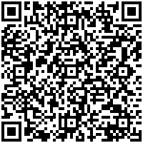
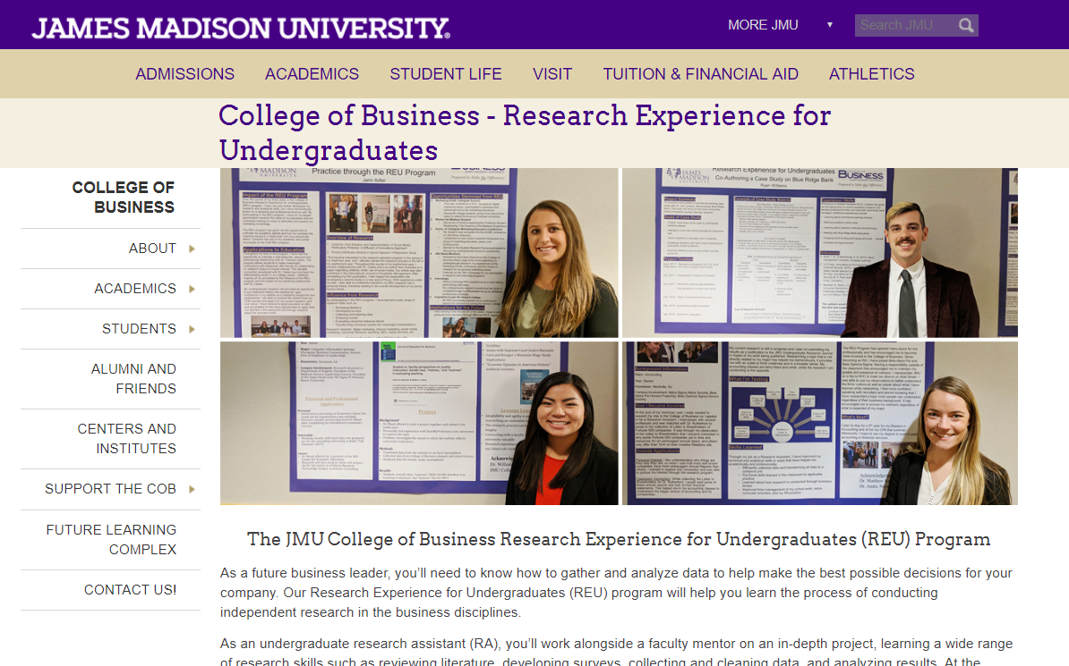
RESEARCH EXPERIENCES FOR UNDERGRADUATE (REU) PROGRAM
General REU Program Information
Student application
Faculty application
Due date for summer applications is April 17th.
Experience has “completion standards” reflecting on the experience.
Student evaluation
Faculty evaluation
April 5th was Poster session/Honors Symposium.

Slide 8
RESEARCH EXPERIENCES FOR UNDERGRADUATE (REU) PROGRAM
General REU Program Information
Student application
Faculty application
Due date for summer applications is April 17th.
Experience has “completion standards” reflecting on the experience.
Student evaluation
Faculty evaluation
April 5th Poster session/Honors Symposium.

Slide 9
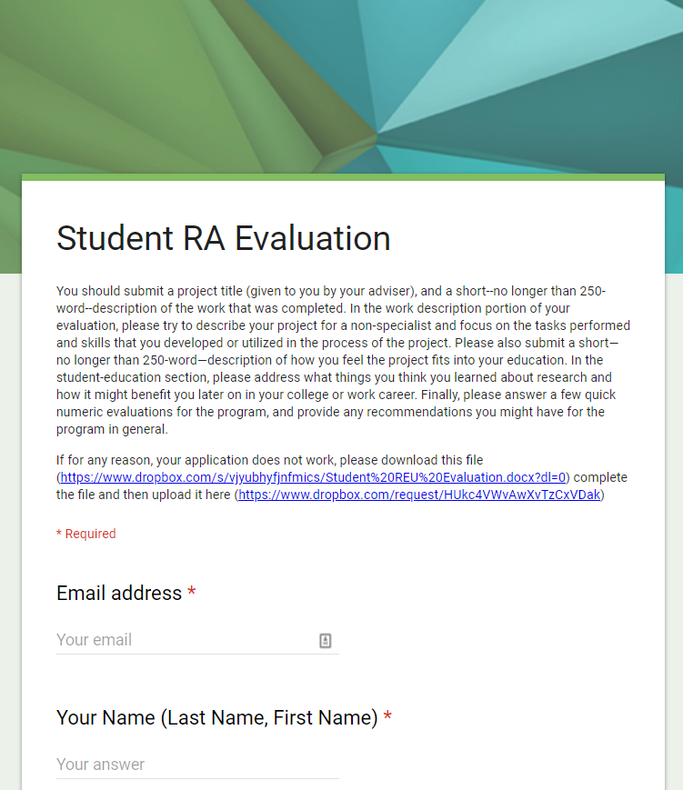
RESEARCH EXPERIENCES FOR UNDERGRADUATE (REU) PROGRAM
General REU Program Information
Student application
Faculty application
Due date for summer applications is April 17th.
Experience has “completion standards” reflecting on the experience.
Student evaluation
Faculty evaluation
April 5th Poster session/Honors Symposium.

Slide 10
Project Titles to Date
A City-County Fiscal Impact Model for Virginia Localities
A portfolio theory approach to basketball shot selection
A Survey of Network-Based Analysis and Systemic Risk Measurement
Access to Capital and the Success of Entrepreneurs in Developing Nations
Agent-Based Macroeconomic Modeling
Agricultural Supply Chain Integration
An Analysis of Media Communication Touchpoints Among Recent Effie Award Winners
An Empirical Investigation of the Chain Version of Heckscher-Ohlin Theory
An Exploration of Changes in Attributes Sought in Sports Apparel
An Investigation of the Effect of Ethical Reasoning Decision Making Instruction on Personal Selling Ethics
Analysis of NCAA Finances
Antecedents to Ethical Decision Making: Individual Characteristics and Training Interventions as Joint Predictors of Ethical Behavior
Applying Situational Theory to Predict Information Security Publics
Are Business Students Less Ethical? The Impact of Personal Values and Moral Standards on Academic Cheating.
Attitudes of Chinese and American students regarding online advertising
Attitudes Towards Programming/CS Courses
AWS Security Lab
Best Companies to work for 2012-2018
Business Analytics Research Assistant
Case study on self-presentation of an NFL player with a disability
Celebrity Chefs' Adoption of Pinterest as a Marketing Strategy: A Pilot Study
CEO Research
Cheating Behaviors in the COB
Co-authoring a case study on Blue Ridge Bank
Comparative Study of Business Students’ Attitudes Toward Statistics
Computer aided text analysis of Fortune 500 Firms' shareholder letters
Computing and analysis support for multiple projects, including online advertising, attitudes toward statistics, supply chain management.
Corporate governance, Earning Manipulation and Cross-listing
Corporate Hedging: Evidence on the Impact of the FASB's Changes to the Hedge Accounting Model
Covered Bond Market Research
Creating a Data Analysis Case
Cross-Sectional Analysis of Economic Freedom, Rule of Law, and World Values
Cybersecurity Education
Data Collection for CEO Medical Leave Announcements
Data Preparation for Structure Equation Model for attitude toward statistics
Demography, Data, etc.
Do the Eight Key Questions Promote Postconventional Reasoning? Survey of Practices of Accounting Researchers
Economic Freedom and Unemployment Since the Great Recession
Economic History
Economic integration and socio-economic indicators
Effects of International Trade on Socio-economic Indicators within Developing Countries
Ethical character, ethical training, and ethical decision-making: How do individual characteristics and training interventions jointly predict ethical behavior?
Evaluating Teaching: Student vs. Faculty Perspectives in a College of Business
Expat entrepreneurs
Experiential Learning for Advanced Predictive Analytics
Experiential Learning in the Hart School
Exploring disability in a professional sport setting through self-presentation: The case of Shaquem Griffin
Finding the Soul of Classical Liberalism
Forecasts of key macroeconomic indicators for the OECD countries: A pseudo-real time series database
Gender and Entrepreneurial Orientation
High Impact Practices in Hospitality Curriculum Development
HTML Widgets
IDEA Data Analytics Case Study
International trade in both goods and services
K2M Business Case
Marketers’ Use of Content Marketing
Marketing Data Archive Project
Mary Washington ED
Mixed methods study of gender based discrimination in media coverage of athletes
Mock Interviews in the Classroom
Modeling measures of information asymmetry as in Odders-White (2008) and Duarte (2015)
Modeling the implementation of VAT tax system in the United States
Modeling the M score measure of earning manipulation as in Beneish (2003).
Moving out of the dorms: should I buy or rent?
Multi-National Newspaper Media Coverage During the Olympics: Representation and Stereotyping of Female Athletes
Offensive Cybersecurity
Optimal Diversity in Business Schools
Personalization and privacy on ATOA
Preparing to Conduct Personal Selling Ethics Survey Research
Proactive scheduling for outpatient clinics
Public Utility Legislative Uncertainty
RateMyProfessors analysis
Regulatory Fit on Various Scenarios
Regulatory Uncertainty in US Power Markets
Relational & Schemaless Database
Re-Thinking Debt Burden: Going with the Flow
Rethinking Divergent Thinking
Risk, Liquidity, and Corporate Social Responsibility
Self-Confidence and It's Impact on Sport Performance
Servant Leadership and Food Safety Practices
Shell Companies and Reverse Merger Activities
Shot Selection and Strategy in the NBA
Skinny Pop Case Study and IPO Data Collection
Socioeconomic Analysis of Developing Countries
Statistical Correlation and Significance in the NBA
Storytellings Impact on GoFundMe Donations
Student vs. Faculty Perspectives on Quality Instruction
Study of Gaming on Risk Attitudes
Survey of Attitudes toward Online Advertising
Text Analytics with WordNet for Curriculum Design
The Decline of Shopping Mall Popularity in the United States
The Financial Impact of Marketing
The Impact of Charter Expansion on Private and Home-School Enrollment: An Arizona Case Study
The Information Environment in Mergers and Acquisitions: Does Search Volume Indicate Quality and Outcome?
The Marketing of Ethics
The relationship of gender on work outcomes
The Social Benefits of Economic Integration
Traditional Celebrities versus Social Celebrities and YouTube Success
Understanding and Preventing Medicaid and Medicare Fraud and Abuse
Unintended Consequences of Helping
Usability Testing of the James Madison University Library Subject Guides
Web Re-design
Women and Entrepreneurism
Worker Well-Being in Social Enterprises and in Non-Social Enterprises
Worldviews and Economic Preferences

Slide 11
Honors - UNDERSTANDING EXPECTATIONS

Slide 12
COMPLETING THE HONORS PROJECT
Expectations
Who should be my adviser or readers?
What are you interested in? What should it look like?
Why do the project?
How do you start the project?
When do I start?

Slide 13
PROJECTS 2009-2018
Accounting
Luke Catania. 2018. Frank J. Wilson: The Father of Forensic Accounting (Louwers)
Samantha McAnallen. 2018. The role of leadership in student organizations (Betancourt)
Caitlin Larrick and Laura R. Salt. 2018. Peer assisted study sessions for financial accounting (Shifflett)
Maria Jones. 2017. The Expanded Auditor’s Report: A Case Study from the United Kingdom (Betancourt)
Jing Jing Jin 2015. Cybersecurity Disclosure Effectiveness on Public Companies (Cereola)
Taylor Selby. 2013. The Threat Financing Cycle (Louwers)
Amanda Cybulski. 2010. A Study in the Complexity of Tax Law in the United States since the Codification of the 1986 Tax Code. (Nichols)
CIS
Devin Boehmer and Sarah Boelsche. (Diener)
Allison Zeppuhar. 2017. Zeppy Low Calorie Alcoholic Beverages Business Plan. (Lending)
Oluwasina Joseph-Ojeniyi. 2013. The Proficient I.T. Consultant: A Study of the Professional. (Dillon)
Fiona Colquhoun. 2012. Alternative-Text Conversion Case Study. (May)
Christine Smith. 2009. Applications of Machine Learning Techniques on Intrusion Detection Systems. (Kruck)

Slide 14
PROJECTS 2009-2018
Economics
Christopher D. Ashley. 2017. The Student Role in Catalyzing an Innovation Movement in Higher Education, Christopher D. Ashley (Interdisciplinary Honors with Dominic Swayne in Military Science)
Keith Pendergrast. 2016. The Impact of Market Perception on Sovereign Default Risk in the European Union. (Bhatt)
Jasmine Grindle. 2016. Όλα καλά (All is Fine): Greece and its Denial of Economic and Financial Negligence. (Elwood)
Eleanor Jordan. 2015. Critical Analysis of the Confounding of Clinical Trials. (Grant)
Laura Stanley. 2013. The Impact of Offsetting Student Behavior on Innovations in Teaching Effectiveness. (Wood)
Anna Faria. 2012. Bittersweet Development: The Role of Sugar and Coffee in Brazilian Economic Growth. (Subrick)
Jeno Pizarro. 2012. The Prospect of Transforming Blight: New Urban Redevelopment in the Shaw-U Street Neighborhood of Washington D.C. (Swartz-Political Science)
David Botello. 2012. A Discussion of the Subprime Mortgage Meltdown and Systemic Amplification. (Fields)
Christopher Gibson. 2009. Willingness to Pay and Consumer Voluntary Price Discrimination: The Case of Online Music. (Wood)
International Business
Armun Asgari. 2012. The Failure of American Automakers in the American Market. (Horn)

Slide 15
PROJECTS 2009-2018
Finance
Bradley Mason. 2016. Tropical Algebra, Graph Theory, & Foreign Exchange Arbitrage (Mathematics with O’Shea)
Emily Blair. 2016. The Effect of the Sarbanes-Oxley Act of 2002 on Earnings Quality (Chowdhury).
Kathleen Fogg. 2016. What Predicts Loan Repayment at Auto Capital? (Schumann).
Matthew Rubino. 2015. The Effects of Quantitative Easing in the United States: Implications for Future Central Bank Policy Makers. (Drake)
Long Bui. 2014. Capital Structure Study: Accounting and Statistics Issues. (Chowdhury)
Stephanie Skaggs. 2014. The Financial Implications of a Cashless Society on Individual Consumers, Business, Banking Institutions, and the Government. (Drake)
Eric Kitchens. 2014. Investor Expectations of the 2007-2009 Financial Crisis: Applying the Bates Model to Modern Stock Market Events. (Fink)
Katie Duquette. 2013. An Analysis of the Linkage between Environmental Sustainability and the Wealth of a Nation. (Liu)
Benjamin McGarry. 2013. A Grounded Theory Examination of the Relationship between Consumer (Dis)Empowerment, Social Media, and Corporate Social Responsibility. (Liu)
Brian Needham. 2010. An Overview of Capital Budgeting Techniques of U.S. Hospitals. (Liu)

Slide 16
PROJECTS 2009-2018
Management
Cory Petinga and Ryan Wimble. 2018. Transfer Student Internal Consulting Project (Cavazos)
Mollie Brooks. 2012. A Survey of Corporate Philanthropy. (Stark)
Meredythe Fallon. 2012. What's Next for the Entrepreneur Graduate? (Stark)
Jessica Merz. 2012. The Effects of Exclusive Contracts on Organizational Competitiveness. (Stark)
Alyssa Richardson. 2012. The Effects of Feminism and Gender on the Organization. (Stark)
Carly Turk. 2011. How Federal Legislation Affects Employee Management. (Stark)
Benjamin Kilmer. 2010. Evolution of the Music Industry: The Effect of Technology and Law on Strategic Management and Sustainability. (Cavazos)
Amanda Ngo. 2009. The Use and Impact of Collateral Signals In Business Presentations. (White)

Slide 17
PROJECTS 2009-2018
Marketing
Jami Adler. 2018. Gender Differences Associated with the Evolution of Attributes Sought in Sports Apparel (Clarke)
Briana Cifelli. 2018. Celebrity chefs as influencers of food well-being (Clarke)
Jennifer Helenek. 2018. Transfer Student Internal Consulting Project (Clarke)
Hayley E. Sunderman. 2017. Creative Advertising Portfolio (Guthrie)
Amanda Zwerin. 2017. An Analysis of Original and Emerging Integrated Marketing Communication Touchpoints Among Recent Effie Award Winners (Clarke)
Morgan Moore. 2015. Intuitive Thought and Consumer Decision Making. (Larsen)
Kelly Pollhammer. 2014. Socially Active Executives as Digital Influencers. (Boyd)
Benjamin McGarry. 2013. A Grounded Theory Examination of the Relationship Between Consumer (Dis)Empowerment, Social Media, and Corporate Social Responsibility. (Boyd)
Laura Jennings. 2012. A Study of Honors Program Attrition: What are they Missing? (Scherpereel/Boyd)
Kathryn Delli-Colli. 2009. Gender Differences in Response to Customer Win-Back Offers. (Tokman)
Jennifer Lodder. 2009. The Distinction Between Impulsive and Compulsive Buying Behaviors: A Review of the Literature and Implications for College-Aged Adults. (Faranda)

Slide 18
SELF-DIRECTED LEARNING
What do you need to succeed?
Who do you need to talk to?
What do you want to learn?

Slide 19
THE HONORS PROJECT – A SUMMARY
The 499 A/B/C
Finding a faculty mentor & topic, second semester Junior year (499A)
Must be a total combination of 6 credits. Can be 499A (1), 499B (2), 499C (3).
499A can be done in summer ($$) and 499B/499C during senior year.
New types of honors projects
Collaborative/Journal-style/Business plan/Capstone
Turning COB300 into an honors project
Areas of emphasis.
Research, Leadership, Global Studies, Service, & Creative.
Introductory & Experiential Seminars in Sophomore year.
Practicum in Junior year. Potential to continue into honors project.
Depth of learning versus a minor.

Slide 20
Students Representing the REU Program
Emily Alford (Marketing)
Alexandra Sward (Economics)

Slide 21
Does a picture tell a story? Impact of emotionally charged pictures on private donations.
Emily Alford

Slide 22
Theoretical Background
Merchant, Ford & Sargeant 2010
When charitable organizations told stories that took people through emotional stages, people were more likely to donate. In addition they felt better donating. We look to extend this finding to charitable organizations to specific people in need. To investigate this research question, we examined specific postings for medical donations, on GoFundMe.

Slide 23
Research Question
Are there any elements of a GoFundMe Campaign that make people more likely to donate?

Slide 24
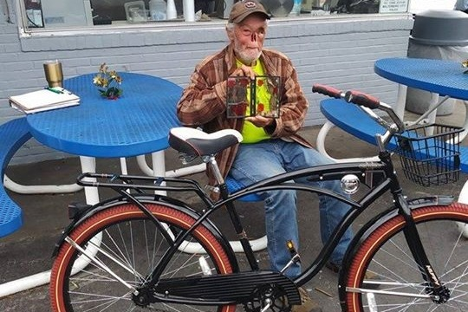
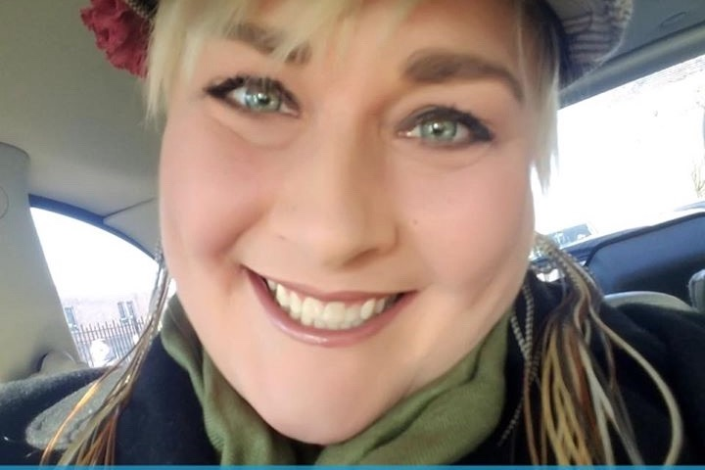
Who would you donate to?

Slide 25
Selecting Data Points
Demographic
Campaign Performance
Gender
Age
Married
Parent
# of Children
Child
Occupation
Private or Public Sector
Race
Religious Comment
Medical Reason
Date Created
Number of Likes on Cover Photo
Goal
Amount Donated
Was the Goal Met?
Total Shares
Time Elapsed
Number of Donors
Number of Pictures
Updates
Highest Donation
Highest Anonymous Donors
# of Donations over $200
# of Anonymous Donors
In top 20
Who wrote the story?

Slide 26
Quantitative Results
Likes on the Cover photo correlated to total donated being higher..508.
Likes on the Cover photo correlated with the number of shares at .684.
Like on Cover photo correlated with the number of donors was at .991.

Slide 27
Key Takeaways as an Undergrad Research Assistant
Good talking points for Interviews
Research design skills
Improved technical skills

Slide 28
COMPETITIVE SCHOLARSHIPS
Competitive scholarships
Hillcrest: $5,000 for Research, Service/Leadership, Global Studies, & Creativity.
Hinshaw-Daniel: (Any Hillcrest area with need).
Frederick I. McGhee: (Entrepreneurship)
Hillcrest Scholarships provide $5,000 to support extraordinary, off-campus summer experiences
Eligibility
Second-year Honors student
Notes:
The Hillcrest Scholarships are exciting because you can design your own program—one that will be the most valuable to you and fit with your academic and professional goals. They can be a bit daunting, too, because they’re so open ended. I will give you a few examples so that you have a sense of what past students have done for their Hillcrest projects.

Slide 29
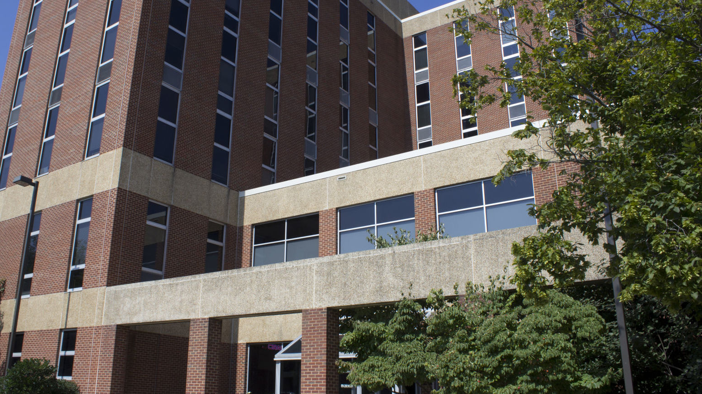
COB300 Honors
Dr. Laura Leduc

Slide 30
Thank You for Coming!

